Slide 1
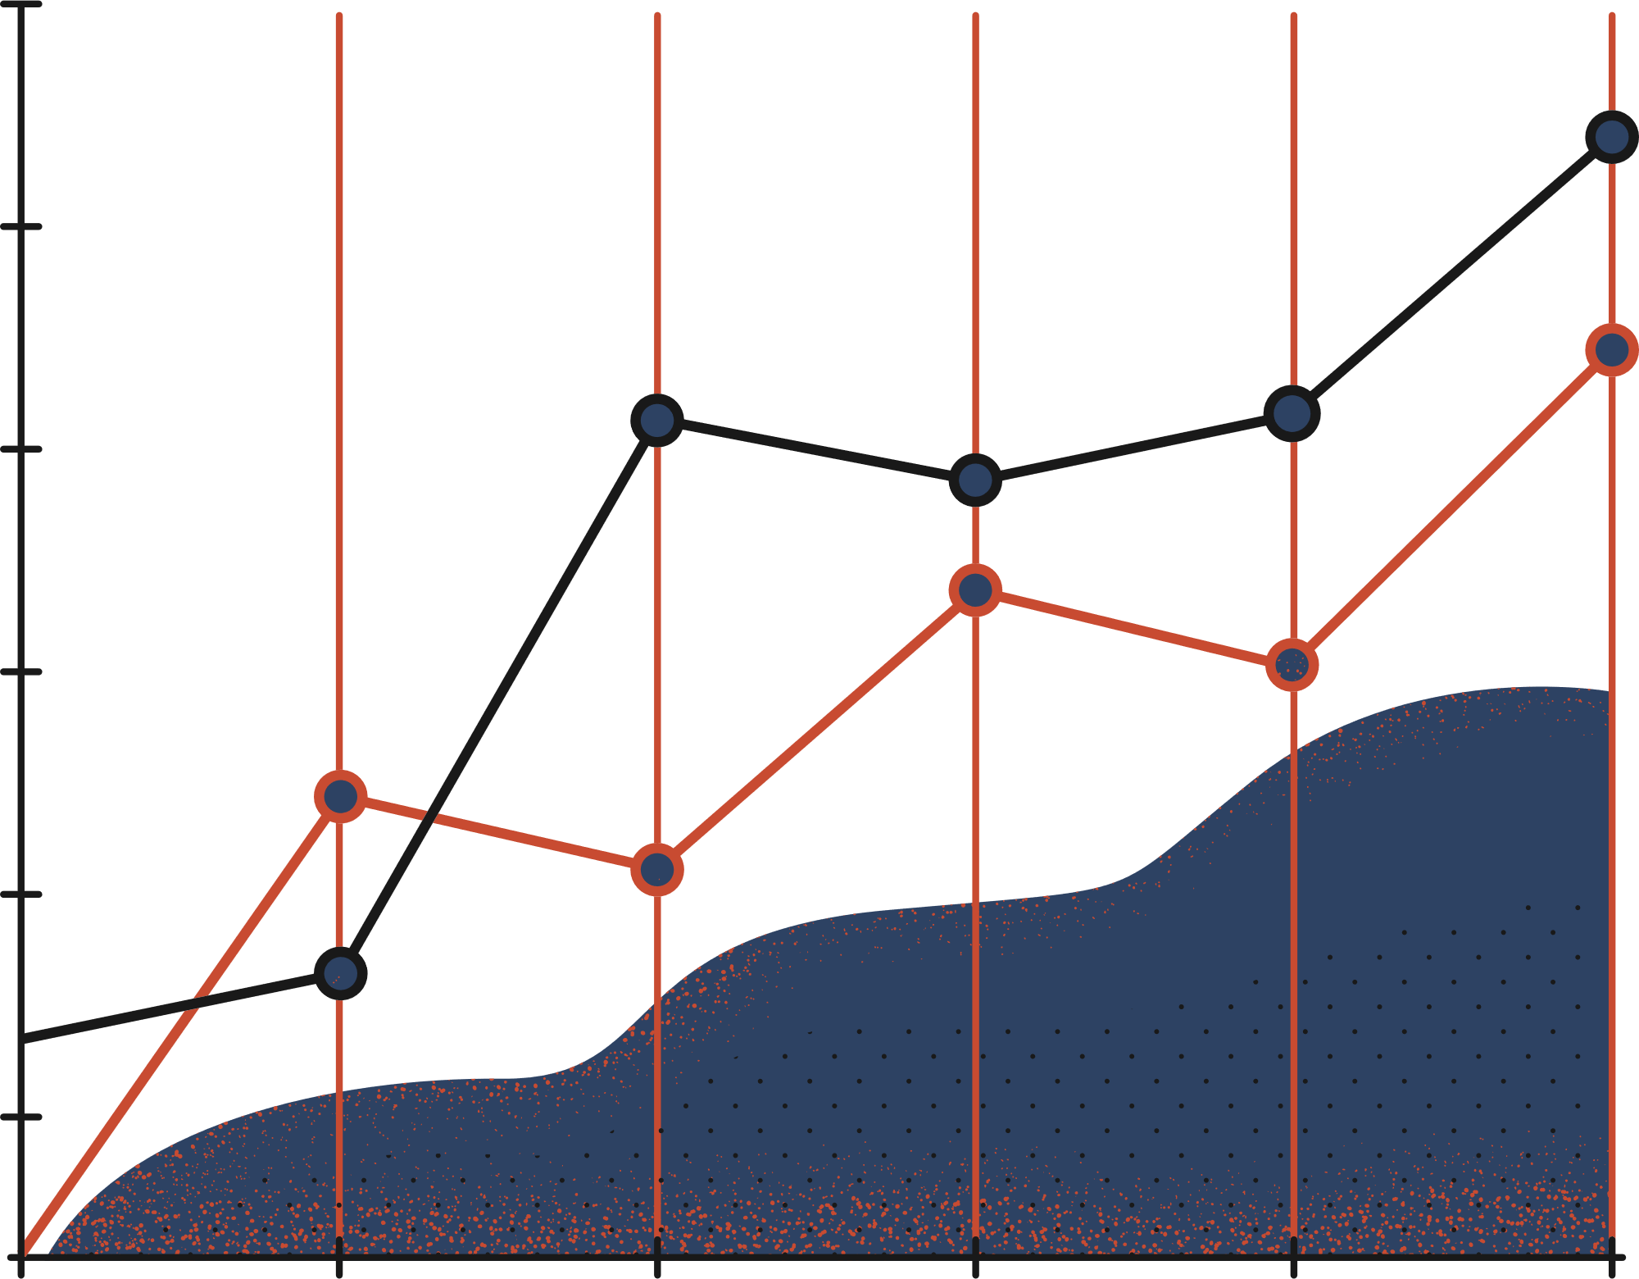

APRIL 21, 2022
IMPEL Course Recommendation System
CAPSTONE TEAM
ADVISOR
SELIM UMIT
JASON KUMAR
DAN CONE
CHRISTIAN ETHERTON
PROF. XIAONING JIN
Notes:
Jason

Slide 2





The Team
Selim Umit
Dan Cone
Professor Xiaoning Jin
Jason Kumar
Christian Etherton
Notes:
Jason

Slide 3


Table of Contents
Page
I
Background & Motivation
4
II
Requirements & System Overview
7
III
Research & Development
12
IV
Conclusion & Discussions
22
V
References
24
Notes:
Jason
For the formal part of our presentation we will be going into the background, we’ll do a high level overview of the system. We’ll cover all of our research and development, and then end with some comments.

Slide 4

I
Background & Motivation
Many job postings consist of requirements that are unrealistic for those entering the labor market, especially within the data science field
Learning the skills and knowledge necessary for this industry can help tackle the growing employment gap
Northeastern professors received a grant to develop a data science curriculum for reskilling workers in the manufacturing industry
Our team was tasked with helping to organize those resources and connecting learners with the courses and modules that best fit their goals
4
Notes:
- Jason
At the moment, labor markets are full of job postings consisting of extremely unrealistic requirements that are nearly impossible to fulfill for those entering the labor market, especially in the case of data science and manufacturing.
Teaching skills and knowledge specific to the data science industry can resolve this exponentially growing problem that creates unreasonable necessities. A new system can help both Students and new Hires utilize their desired jobs in not just identifying what they are required to learn, but also obtaining a customized curriculum that can efficiently prepare them for the job.
The NSF funded Integrative Manufacturing and Production Education Leveraging Data Science (IMPEL) grant to develop create this module recommendation system
Our team was tasked with helping in developing the system, and organizing those resources and connecting learners with the courses and modules that best fit their goals

Slide 5

I
Background & Motivation
Current State
The Problem
Students and new employees independently research what is needed to prepare for their desired jobs
Without guidance, learners cannot identify and prioritize the resources that best align with their career goals
The Cost
Ideal State
Significant time and energy is wasted on some resources; and some learners may give up
Students and new employees are given customized resources that help prepare them for the jobs that they desire
5
Notes:
Jason
Now I am going to go through the current state and ideal state of the system along with the problems and the cost
In the current state of the system, students and new employees will need to independently research what course material and skillsets they will be required to be experienced in for their desired job. They could have a lot of resources at their disposal like academic advisors, advise from professors, etc, but no central resource to turn to.
We designated this as our problem. Without proper guidance. Learners are not able to identify and prioritize resources that best align with their career goals. This leads them to pursue a path that might not be customized and tailor-made to their goals.
In turn, this causes a significant waste in time and energy on an inefficient path.
The ideal state of the system which we are trying to achieve involves students and professionals being provided with a plan and set of resources customized for their academic & professional goals, providing them a overall better chance at success at their desired career path.

Slide 6

I
Background & Motivation
IMPEL’s Desired Solution
BENEFITS
A course recommendation system that prescribes a set of modules aligned with a learner’s expertise, the level of expertise required for their desired job, and skills related to that job
The system will save both time and energy and give learners confidence about their efforts in the form of a path forward
6
Notes:
Jason
I will now give an overview of our system at a high level.long with its benefits, and the approach taken.
Our system that connects a set of modules aligned with a learner’s expertise, the level of expertise required for their desired job, and skills related to that job.
This system would complement other previously mentioned resources such as your academic advisor, and career center, and saves students time & energy in research of their career path, and provides them with a customized career-oriented path forward.

Slide 7


II
Requirements & System Overview
CRITICAL SUCCESS FACTORS
Functional Course Recommendation System
IMPEL Team Buy-In
Maintainable Final Solution
Capstone Deliverables Met
KEY PERFORMANCE INDICATORS
Intuitive and Efficient User Interface
Scalable for Additional Classes
Output matches Expert Decisions
Test Subjects’ Feedback Quantity
7
Notes:
Selim
We had several Critical Success Factors, chiefly that our course recommendation system functioned. We also needed buy-in from our customer – the IMPEL team, and we needed to make sure our final solution was something they could easily manage.
Our KPIs were mostly qualitative in nature. We needed the UI to be easy to use and efficient. We needed the entire system to be scalable. And we needed the output to be relevant. We gauged our performance based on surveys which also helped us iterate and make improvements.

Slide 8
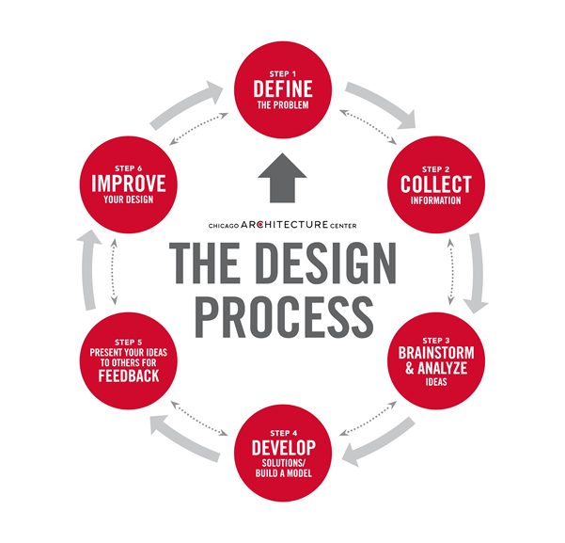
II
Requirements & System Overview
IE TOOLS
Design Process
Human Factors
Lean Principles:
Focused on End-User
Identifying Waste
8
Notes:
Selim
We used several tools common to the industrial engineering field but focused primarily on three lens: the design process (especially defining and redefining the problem), human factors as they related to the usability of our user input and the usability for the back-end for future owners of the system, and finally several lean principles. We wanted to do a lot with the system and had many ideas of what would best serve our learners, but ultimately only so many inputs and processes made the cut

Slide 9

II
Requirements & System Overview
SOLUTION APPROACH
Methods used to build the course recommendation system:
Identifying available resources
Outlining the needs of the user
Accumulating knowledge from subject matter experts
Formulating connections between subject matter and course modules
Surveying for feedback to iterate and improve the solution
9
Notes:
Selim
Our team employed several methods in order to connect the end-user’s desires with the provided course content.
These methods included Identifying available resources needed for success of the course recommendation system,
We also outline any professional or academic needs of the user
We gathered connected with multiple subject matter experts and they provided feedback on how to improve our project.
Through various team discussions we formulated connections between subject matter and course modules
Lastly, we created and distributed a survery for feedback to improve the solution

Slide 10
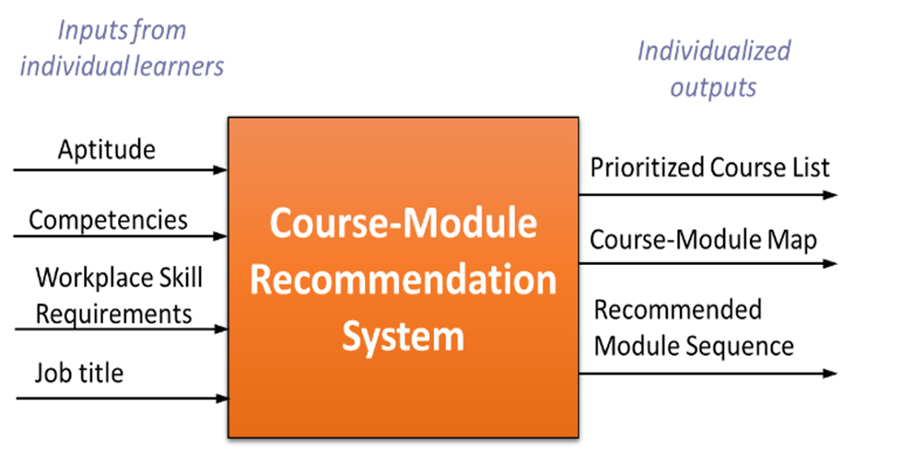
II
Requirements & System Overview
APPROACH TAKEN
User’s Inputs → Course Recommendation
Learner inputs include ONLY most pertinent info
Output should meet user User’s Desires
10
Notes:
CHRISTIAN
So Jason spoke a bit about the foundations of the project and Selim spoke about specifications. I’m going to give you a quick high-level overview.
Ultimately, the learner or user will enter something into the system, and out will pop course (or more specifically “module”) recommendations
The user will put in information that is specific to their abilities and desires, and then the system should be such that the final recommendations aligns with the specific user.

Slide 11
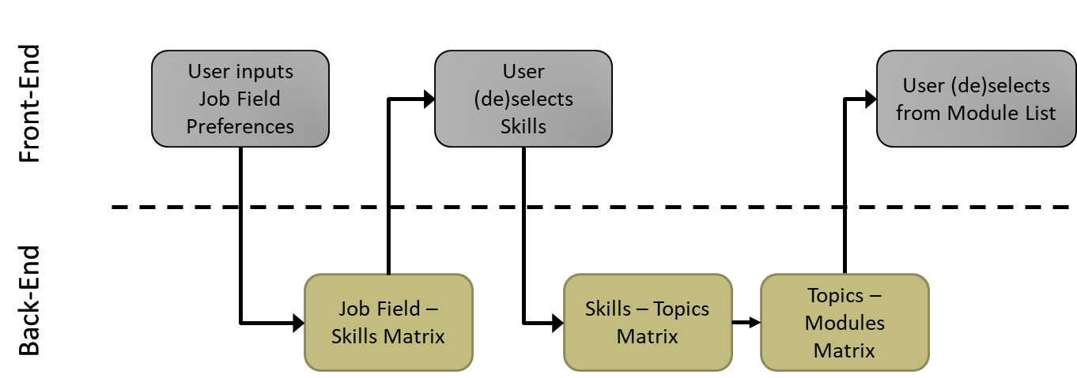
II
Requirements & System Overview
User Input
System Output
Mapping & Algorithm
11
Notes:
CHRISTIAN
This is a model of our particular system. Everything on the top half is the front-end with which the user sees and interacts. The bottom half is the back-end where everything is processed.
The user begins by identifying their expertise, the expertise needed for the jobs they desire, and their desired job field. The desired job field reveals related skills or knowledge domains from which the user can choose. This then goes back to the back-end where additional matrices map the selected skills and domains to topics which are finally mapped to the modules.

Slide 12
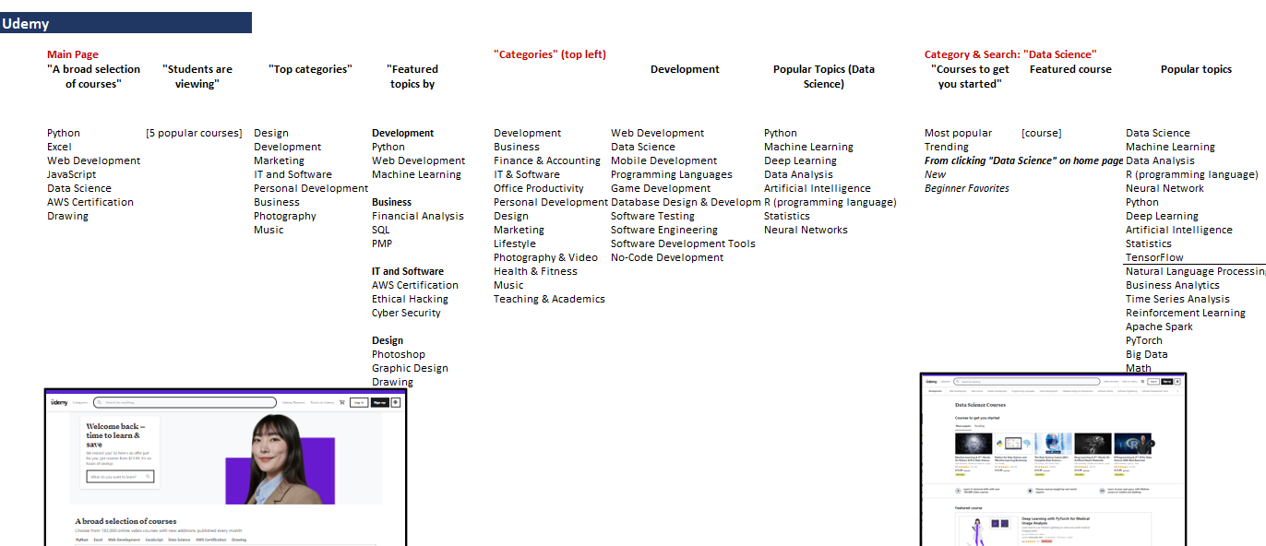
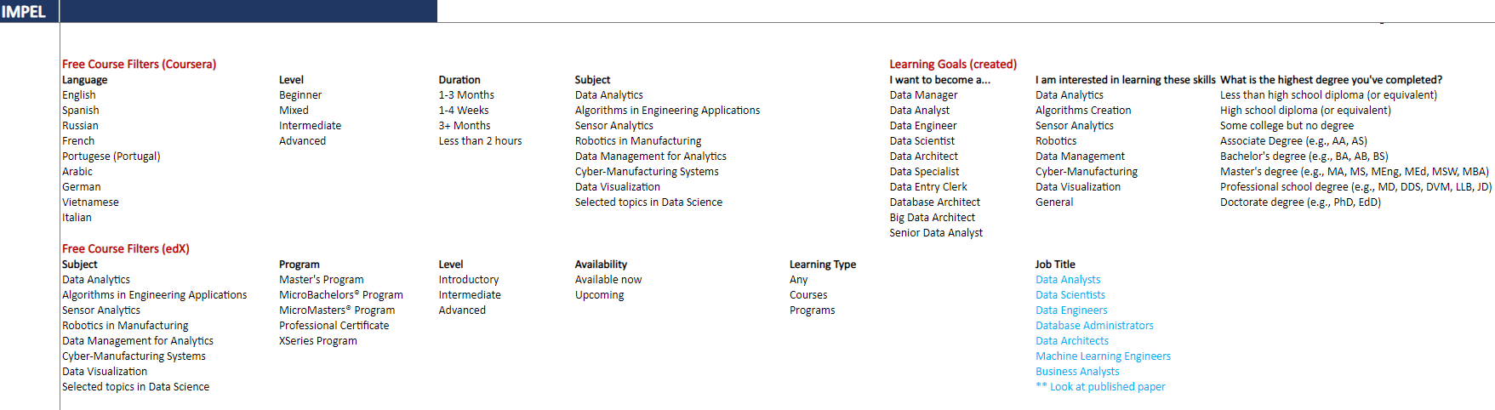
III
Research & Development
Competing course selection processes:
Coursera
LinkedIn Learning
Udemy
edX
Udacity
12
Notes:
CHRISTIAN
After understanding the problem, we began our work by investigating User Interfaces and Course Recommendation Systems at other well-known platforms, like Coursera and LinkedIn Learning
The specifics of these lists are really unnecessary, but the higher screenshot shows how we looked at all the ways in which people are guided to courses in those platforms
And then the bottom screenshot shows how we filtered down the ways to look at those that work best for people who we know are already interested in data science.

Slide 13
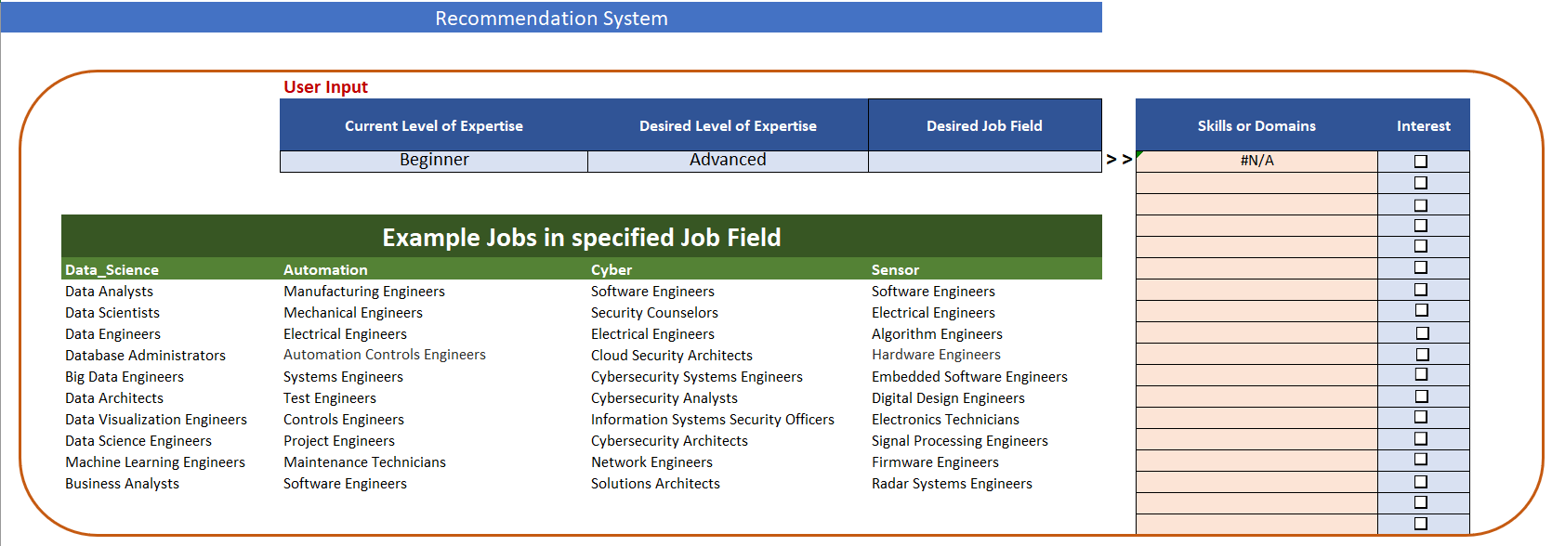
III
Research & Development
13
Notes:
CHRISTIAN
Here’s our solution for the initial user interface where users contribute their inputs into the light blue cells
Users share their current and desired levels of expertise, and then they choose between 4 job fields. We included the top or most common jobs associated with each job field to help the user select whichever is most appropriate for them.

Slide 14
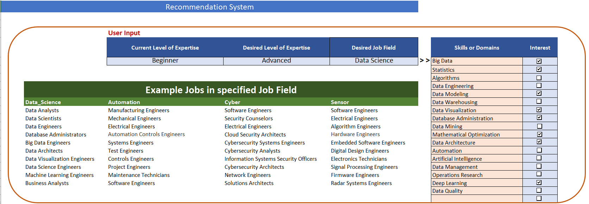
III
Research & Development
16
Notes:
CHRISTIAN
This leads us to our first matrix in the back-end which will populate the yellow-colored column on the right
It’s based on a list of skill or knowledge domains that are trending and highly correlated with each job field.

Slide 15

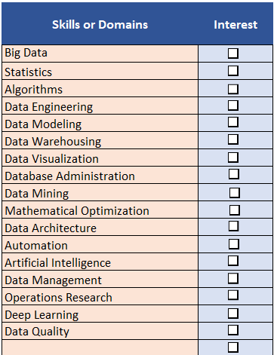
III
Research & Development
PROS
Simple
Usability is high
Straight forward output
CONS
Reductionistic
17
Notes:
CHRISTIAN
Here’s a close-up of the skills or domain column
The user can then down-select whichever skills or knowledge domains most align with their interests or the description of their desired jobs
This interface and process really guides the user through aligning the system to their interests without asking too much of them.
We did want to involve more inputs but there was only so much research available on how everything was correlated, so our system is a bit reductionistic, but only as much as it needs to be.
Now to Dan to discuss how the system actually makes its recommendation

Slide 16
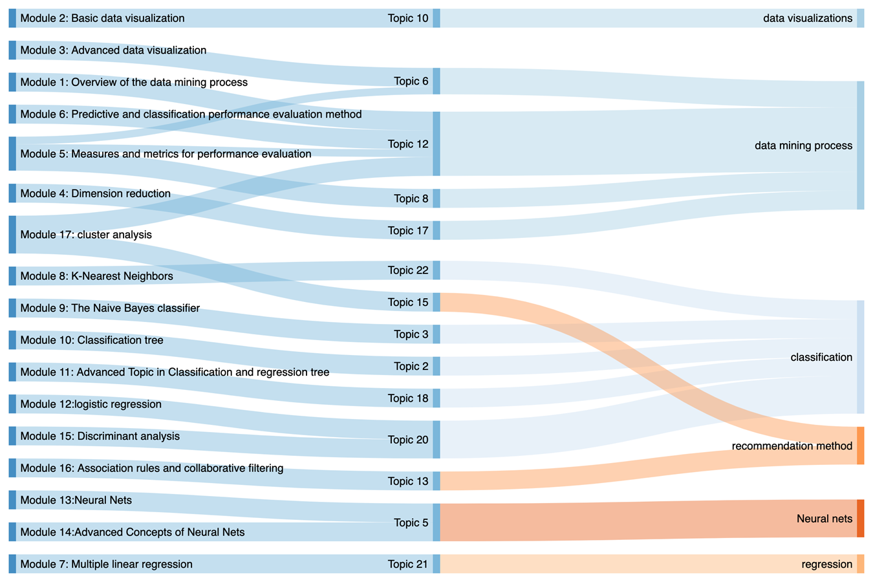
III
Research & Development
Link between the Keyword (Topics) and what we present to users
Skill – Topic Matrix
COURSE SIDE
USER SIDE
14
Notes:
Dan
A graduate student on the IMPEL team, Guoyan Li, used an algorithm (called LDA) to process many resources associated with data science in manufacturing to come up with a list of topics
These topics were then mapped to the same skills and knowledge domains that are associated with the chosen job field.

Slide 17
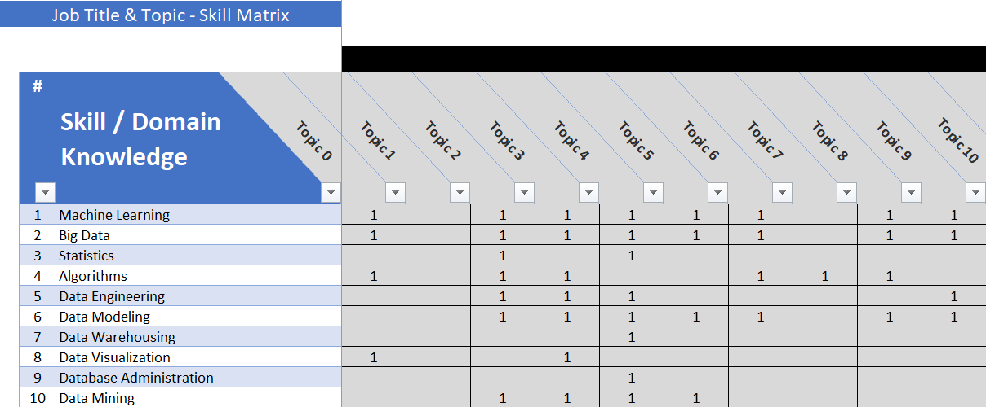
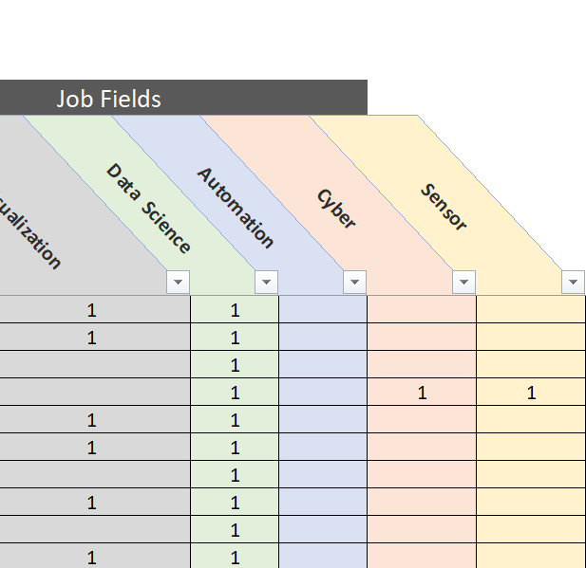
III
Research & Development
15
Notes:
-Dan

Slide 18
III
Research & Development
Link between the Keyword (Topics) and what we present to users
Topic-Module Matrix
COURSE SIDE
USER SIDE
18
Notes:
-Dan

Slide 19
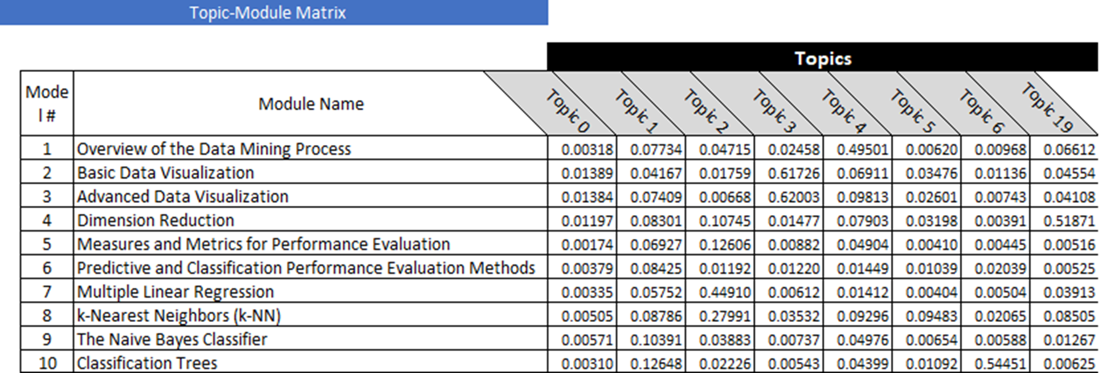
III
Research & Development
19
Notes:
-Dan

Slide 20

III
Research & Development
INITIAL SOLUTION & FEEDBACK
Design Review
Dr. Shui, ML and AI researcher at Ford
Strong recommendation for the system output to include additional courses for the user to select
20
Notes:
Dan
With the help of an outside design reviewer, Dr. Huanyi Shui, a machine learning and artificial intelligence researcher at Ford Motor Company, additional updates were made to the user interface.
Dr. Shui strongly recommended that the output of the user interface include additional courses the user could select that might not align perfectly with their inputs but might still align with the ultimate goals.

Slide 21
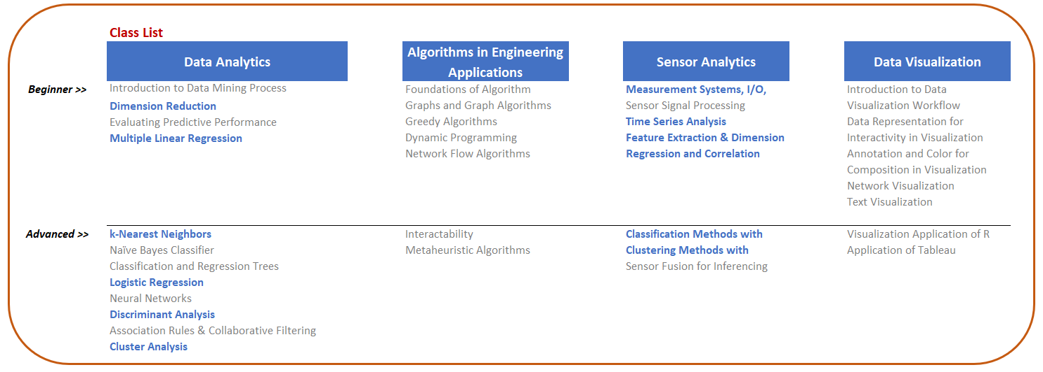
III
Research & Development
PROS
Output is easy to understand
Can still see every class
Recommended courses clearly visible
CONS
No prioritized order
21
Notes:
-Dan

Slide 22

IV
Conclusion & Discussions
ITERATED SOLUTION & FEEDBACK
Initial Survey
Roommate recruitment
Feedback on the Survey
Future Feedback
MVP
Updated Survey
Hand-off
IMPEL Ownership
NEU Canvas Incorporation
22
Notes:
Selim
The next phase of prototype development involved recruiting roommates and close friends to take surveys on the effectiveness of the recommendation system and the survey itself. We took their feedback, revised the survey, and made minor adjustments to the system.
We now have a minimum viable product and a survey that should continue to generate more feedback along the lines of our KPIs and CSFs. These will be used in the later stages of the IMPEL program, as the team finalizes the course content and develops a course recommendation system native to the Canvas platform.

Slide 23
IV
Conclusion & Discussions
SOCIETAL & GLOBAL IMPACTS
Locally this recommendation system could be adopted by universities as a more efficient course selection system
IMPEL integration into Canvas would expand the system to every reach of the country
Would allow for earlier course planning removing the anxiety and overwhelmingness of selecting courses upon arrival at University
DIVERSITY, EQUITY, INCLUSION ISSUES
System must be accessible to all demographics and those who desire to learn
System must also be capable of working in multiple languages and not exclusively English
23
Notes:
- Selim

Slide 24
V
References
S. Kamarthi, "IMPEL Overview" presented to Team 6, MEIE 4701 Capstone 1, Northeastern University, Boston, MA, May 5, 2021. [PowerPoint slides]. Accessed on: June 13, 2021.
Symeonidis, P., & Malakoudis, D. (2018). Multi-modal matrix factorization with side information for recommending massive open online courses. Expert Systems with Applications, 118, 261–271. https://doi.org/10.1016/j.eswa.2018.09.053
Lopez, V., Santos, M., Esteve, P., Roldan, D., & de Mendoza, J. C. (2010). Practical applications of Intelligent Systems: An E-learning platforms recommender. 2010 IEEE International Conference on Intelligent Systems and Knowledge Engineering. https://doi.org/10.1109/iske.2010.5680766
Qomariyah, N. N., & Fajar, A. N. (2019). Recommender System for e-Learning based on Personal Learning Style. 2019 International Seminar on Research of Information Technology and Intelligent Systems (ISRITI). https://doi.org/10.1109/isriti48646.2019.9034568
24
Notes:
Selim

Slide 25
V
References
George, Steve, and Kumar, Ravi, S. “Why Skills - and Not Degrees - Will Shape the Future of Work.” World Economic Forum, 21 Sept. 2020, https://www.weforum.org/agenda/2020/09/reckoning-for skills/.
IMPEL Working Group, "Job Market Data Analysis-Key Results," presented to Capstone 1, Northeastern University, Boston, Massachusetts, United States, June 23rd, 2021. [PowerPoint slides]. Available: Powerpoint link , Accessed on: June 23rd, 2021.
M. Salehi and I. N. Kmalabadi, “A Hybrid Attribute–based Recommender System for E–learning Material Recommendation,” IERI Procedia, vol. 2, pp. 565–570, 2012.
J. Buncle, R. Anane, and M. Nakayama, “A Recommendation Cascade for e-Learning,” 2013 IEEE 27th International Conference on Advanced Information Networking and Applications, pp. 740–747, 2013.
E. Mangina and J. Kilbride, "Evaluation of key phrase extraction algorithm and tiling process for a document/resource recommender within e-learning environments", Computers & Education, vol. 50, no. 3, pp. 807820, 2008. Available: 10.1016/j.compedu.2006.08.012.
25
Notes:
Selim

Slide 26

The End
Thank you
for listening
Notes:
Selim

